Slide 1
Eight Numbers on a Cross

Slide 2
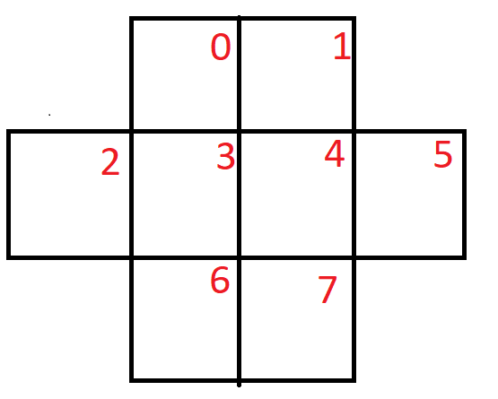
What is the problem?

Slide 3
What’s the problem?
We want to put the numbers 1 - 8 on the cross such that no two adjacent spaces contain consecutive integers.

Slide 4
Our approach
We generate a sequence s = {} stored in a container q[].
The indices of q will represent the position on the cross. The values inside at those indices will represent the value stored on the cross.
When we have a possible arrangement, we will pass our array into an ok function and that function will tell us whether that number is good to put in the sequence s.

Slide 5
ok Function()
We check for conflicts up to the value we are trying
sequence s []
Add that item to our sequence
Values to use for our sequence s:
1, 2, 3, 4, 5, 6, 7, 8
Backtrack
Repeat until we have finished our sequence

Slide 6
OK Function
Much of the difficulty of this problem is going to be concerning the OK function.
The OK function has to check adjacency and that value is not already used in our sequence of values.
The array tells you nothing about which positions on the cross are going to be adjacent with each other.

Slide 7
How can we store information about adjacency?
We have to use a helper array
A helper array will let us know which positions on the cross will be adjacent to which other positions on the cross.
The helper array will tell us which values in the array q that we should check.
It will tell us that we don’t have to check anymore values through the use of sentinel, a value that is reserved to tell us that we are done with our search.

Slide 8
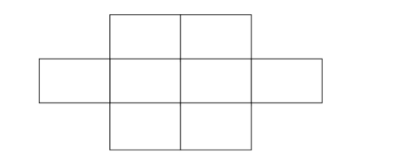
Let’s see this through an example

Slide 9
0
1
2
3
4
5
6
7
Label the positions

Slide 10
0
1
2
3
4
5
6
7

Slide 11
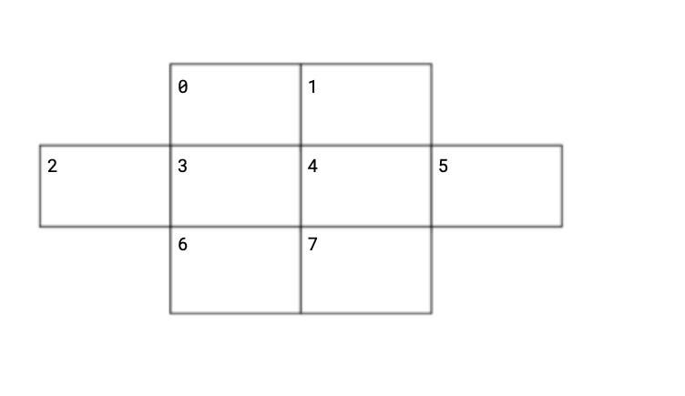
Create a table based on the labelling
Position
0 | -1
1
2
3
4
5
6
7
Numbers on cross are label for position

Slide 12
How would that table look like in code?

Slide 13
Let’s consider another example

Slide 14
0
Note: Numbers represent box positions
1
2
3
4
5
6
7
What would the adjacency table look like for this?

Slide 15
Position
0
1
2
3
4
5
6
7
0
1
2
3
4
5
6
7

Slide 16
0
1
2
Note: Numbers represent box positions
3
4
5
6
7
What would it look like for this example

Slide 17
0
1
2
Position
0
1
2
3
4
5
6
7
3
4
5
6
7

Slide 18
Note: Numbers represent box positions
0
1
2
3
4
5
6
7
What about this example?

Slide 19
Position
0
1
2
3
4
5
6
7
0
1
2
3
4
5
6
7

Slide 20
0
1
3
5
2
4
6
7
What about this example? Note the numbering

Slide 21
P
0
1
2
3
4
5
6
7
0
1
3
5
2
4
6
7

Slide 22
Takeaways from these examples
Look at how each of these different types of tables were created for each of example.
The adjacency table is a helper array that will work for any types of numbering and layouts of the grid.
It will work as long as you are consistent with your approach.
Remember that when you are creating these tables, you will be putting items consecutively (position 0, position 1, 2, 3, … )
This will dictate what will be adjacent in our table at a specific time (Look at slide 21).

Slide 23
How do we put into practice?
With the adjacency table we know exactly what values to check when it comes to our index position.
How? Well if we are looking at index 3 in q, then we just have to look at a[3][i] and keep incrementing i until the value of a[3][i] is ‘-1’.

Slide 24
Ok Function
We can now incorporate the adjacency table into our determination of whether or not a potential number is okay.
We can pass in s to the ok function. The function check if the number has been used and whether or not there is going to be any types of conflicts based on what is adjacent to our position (using the table).

Slide 25
Adjacency Array
Ok function
Sequence s{} stored in q

Slide 26
Things to keep in mind of
Remember what the adjacency table is and what the actual sentinel value will tell us.
How are you going to check for each value that is adjacent (hint: you are checking a series of values until…)?

